Slide 1
Training a Model : 1. In case of supervised learning, a model is trained using the labelled input data. However, how can we understand the performance of the model? The test data may not be available immediately. 2. That is the reason why a part of the input data is held back (that is how the name holdout originates) for evaluation of the model.

Slide 2
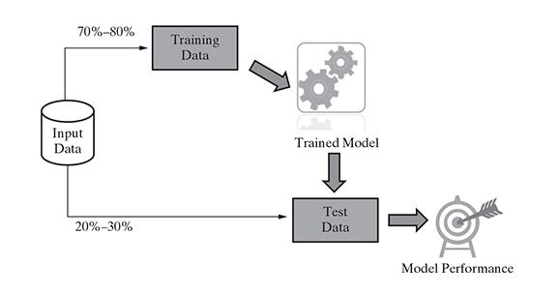
This method of partitioning the input data into two parts – training and test data which is by holding back a part of the input data for validating the trained model is known as holdout method.

Slide 3
K - FOLD CROSS VALIDATION
Training set
Model
Dataset
70 : 30
75 : 25
Evaluate
Testing set

Slide 4




K - FOLD CROSS VALIDATION
….but in exam you have questions from linear algebra as well as calculus.
All semester your professor has taught linear algebra.
your professor should have taught calculus as well...
So you prepare for linear algebra during exam.

Slide 5
this is the problem with simple train test split…….
we don’t have this light green point in our training so when we evaluate our model for this green point it will give false prediction as our model is not trained on this light green point.
D
A
T
A
S
E
T
Model
Training
Testing
Evaluate
K-fold cross validation…...

Slide 6
We divide our dataset in K folds.
the first task is to choose the value of K
Let’s say K = 5
Testing set
Training set
Calculate accuracy, let's call it acc1...

Slide 7
We divide our dataset in K folds.
the first task is to choose the value of K
Let’s say K = 5
And rest are training set.
Testing set
Calculate accuracy, let's call it acc2...

Slide 8
We divide our dataset in K folds.
the first task is to choose the value of K
Let’s say K = 5
And rest are training set.
Testing set
Calculate accuracy, let's call it acc3...

Slide 9
We divide our dataset in K folds.
the first task is to choose the value of K
Let’s say K = 5
And rest are training set.
Testing set
Calculate accuracy, let's call it acc4...

Slide 10
We divide our dataset in K folds.
the first task is to choose the value of K
Let’s say K = 5
Final accuracy = (acc1 + acc2 + acc3 + acc4 + acc5) / 5
And rest are training set.
Testing set
After all the folds have served as training and testing set we take the average of all the accuracies
Calculate accuracy, let's call it acc5...

Slide 11
Bootstrap Sampling
Bootstrap sampling or simply bootstrapping is a popular way to identify training and test data sets from the input data set. It uses the technique of Simple Random Sampling with Replacement (SRSWR), which is a well-known technique in sampling theory for drawing random samples
As in K-Fold Cross-Validation data instances from partition as test data and the remaining partitions as training data whereas in Bootstrapping it randomly picks data data instances from the input data set, with the possibility of the same data instance to be picked multiple times

Slide 12
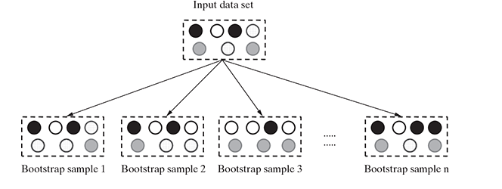

Slide 13


